Slide 1
Intelligent Transportation Systems Joint Program Office (ITS JPO) Professional Capacity Building (PCB) Webinar Series Crowdsourcing for Operations Course
May 16, 2023

Slide 2
DISCLAIMER
The U.S. Government does not endorse products or manufacturers. Trademarks or manufacturers’ names appear in this presentation only because they are considered essential to the objective of the presentation. They are included for informational purposes only and are not intended to reflect a preference, approval, or endorsement of any one product or entity.
This presentation was created by the FHWA, and it is being presented by FHWA and other State and local agencies. The views and opinions expressed in this presentation are the presenters’ and do not necessarily
reflect those of FHWA or the U.S. Department of Transportation (USDOT). The contents do not necessarily reflect the official policy of the USDOT. The contents of this presentation do not have the force and effect of law and are not meant to bind the public in any way.

Slide 3



Today’s Host and Presenters
Greg Jones, Host
Every Day Counts 6 (EDC-6) Crowdsourcing Colead
FHWA Office of Operations and Resource Center
James Colyar, Presenter
EDC-6 Crowdsourcing Colead
FHWA Office of Operations
Natalie Bettger, Presenter
Senior Program Manager
North Central Texas Council of Governments (NCTCOG)
Source: FHWA.
Source: FHWA.
Source: NCTCOG.

Slide 4

Webinar Agenda
1:10 p.m. FHWA EDC-6 Crowdsourcing Innovation and Course
1:15 p.m. Introduction to Crowdsourcing Lesson
1:35 p.m. Applications of Crowdsourced Data Lesson
2:00 p.m. Question and Answer
Source: Unsplash.

Slide 5
What Is Every Day Counts?
State-based model
Proven but underutilized innovations
2-year cycles

Slide 6

EDC-6: Deeper Crowdsourcing Roots for a Bountiful Suite of Benefits
EDC-5 Crowdsourcing Innovation (January 2019–December 2020) continued as an EDC-6 Innovation (January 2021–December 2022), with focus on:
Adding data sources and applications
Improving data management
Improving archived data usage
Sharing and integration of data
Source: FHWA.

Slide 7
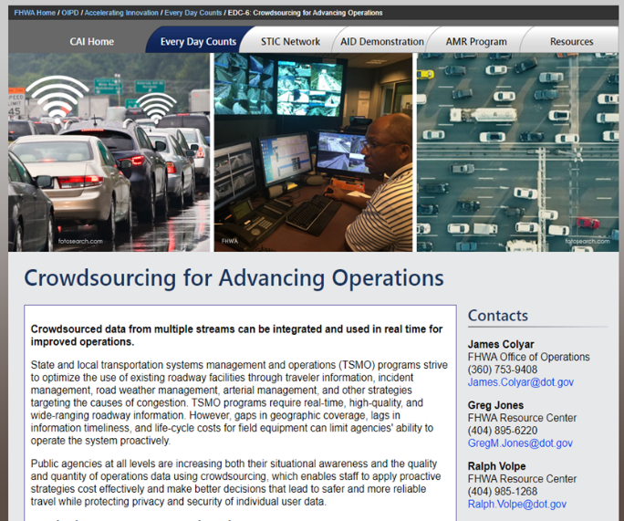
EDC Crowdsourcing by the Numbers: January 2019 ‒ December 2022
35+ States and many local agencies engaged
10+ workshops and peer exchanges
15+ conference and event presentations
20+ Adventures in Crowdsourcing webinars
20+ technical assistances or facilitations
12 crowdsourcing cohort sessions
10+ published articles and 5+ case studies
Crowdsourcing Course-in-a-Box delivered to 3 regions
Source: FHWA.
FHWA EDC-6 Crowdsourcing for Advancing Operation
Resource Site

Slide 8

Crowdsourcing Course in a Box
Course Goals:
Broaden understanding and knowledge about how crowdsourced data can improve transportation operations
Help participants consider whether specific applications of crowdsourcing may meet their organizations’ needs
Course Tools:
Editable instructor templates
Instructor materials
Course slide decks
Student materials
Source: Pixabay.

Slide 9

Course Is Modular by Design
5 Lessons: Introduction, Data Sources, Application Areas, Data Management, and Next Steps
6 Application Modules: traffic incident management, traveler information, arterial management, work zone management, road weather management, and emergency management
Data
Sources
Application
Areas
Introduction
Data
Management
Next Steps
Source: Adapted from Pixabay.
Source: Adapted from Pixabay

Slide 10
Whom Is the Course Targeting? Transportation Groups
Public works departments
Emergency planning
Work zone
Safety and planning
Traffic management centers (TMCs)
Traffic signal systems
Operations
Maintenance
Consider nontraditional invitees such as policy makers, local elected officials, administrators, or other leaders.

Slide 11
Whom Is the Course Targeting? Sample Job Titles
Traffic engineer
Maintenance manager
Safety specialist
Transportation systems and management (TSMO) manager
Mobility engineer
Intelligent transportation systems engineer
TMC manager
Performance manager
Innovation manager
Safety engineer
Freeway operations manager
Planner
Traffic signal system manager
Researcher
Data steward

Slide 12

LESSON: INTRODUCTION
Source: Pixabay.

Slide 13

Introductions
Please enter your name, agency, and title in the chat window.
Please state a problem your agency faces to which crowdsourced data might offer a solution.
Source: FHWA.

Slide 14
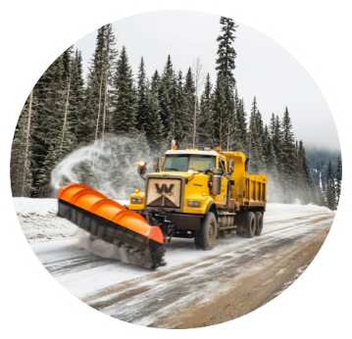

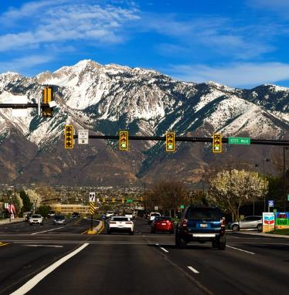

Lesson Objectives
Describe crowdsourcing in general and for TSMO
Understand the benefits from crowdsourcing for TSMO
Source: Unsplash
All photos source: Unsplash.
14

Slide 15
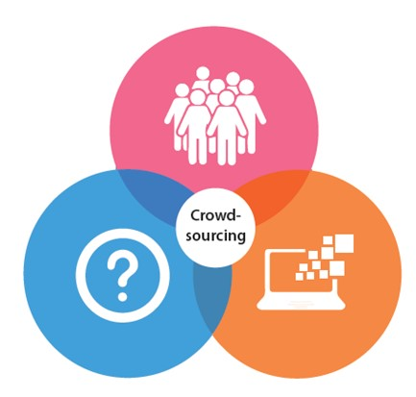
What Is Crowdsourcing?
Addressing a need or problem by enlisting the services of a large number of people via technology
Source: FHWA.

Slide 16

Lifelines: 50:50 Phone a Friend Ask the Audience
Source: Idea SV, El Salvador Milonario.
How often is the ask-the-audience lifeline correct
in the game show “Who Wants to Be a Millionaire”?
A: 95% of the time
B: 50% of the time
A: 95% of the time
C: 30% of the time
D: 75% of the time

Slide 17

Crowdsourcing Is Everywhere
Airbnb
Best Buy
Citizenscience.gov (GSA)
Department of Defense
Facebook
Federal Bureau of Investigation
General Electric
Google
Harley-Davidson
Kraft Foods
Lego
Mattel
McDonald’s
Microsoft
NASA
Netflix
New York City
Procter & Gamble
Starbucks
Wikipedia
Source: FHWA.

Slide 18

Transportation Systems Management and Operations
Optimize existing facilities
Move people and goods
Target causes of congestion
Built on a foundation of monitoring current conditions
Source: Unsplash.
Source: Pixabay.

Slide 19

Transportation Systems Management and Operations Needs
Monitoring the roadway network
Detecting problems more quickly
Providing better information for road users
Making planning, operational, and maintenance decisions with data
Improving safety and reliability
Source: Unsplash.

Slide 20
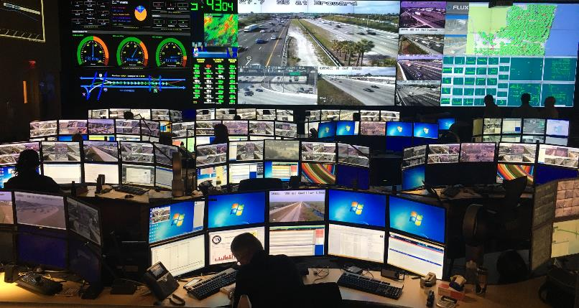
Real-Time Monitoring Limitations
Gaps in geographic coverage
Timeliness of information
Jurisdictional stovepipes
Cost to deploy and maintain equipment
Source: FHWA.
Crowdsourced data overcome the limitations of traditional ITS infrastructure-based traffic monitoring.

Slide 21

Types of Crowdsourced Data for Transportation Operations
Vehicle probe​
Navigation app​
Social media​
Connected vehicle​
311 and 511 apps​
Multimodal probe data​
Source: Pixabay.

Slide 22
Integrating Crowdsourced Data
Crowdsourced Data
Traveler Information
Operations Group
TMC
Signals System
Maintenance and Traffic
Citizen Calls
Incident Management
ITS Field Devices
Freeway Traffic Management
Third-Party Data
Arterial Management
Partner Data
Road Weather Management
Service Patrol
Many Other Applications
Source: FHWA.

Slide 23
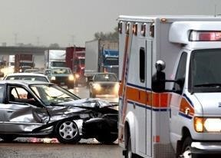
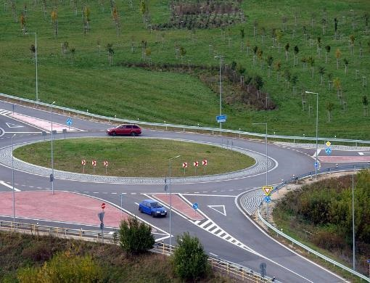
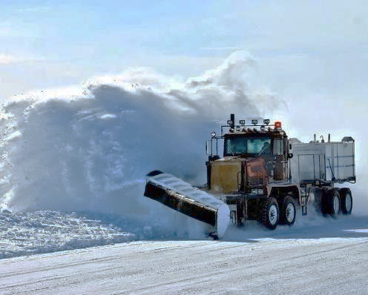


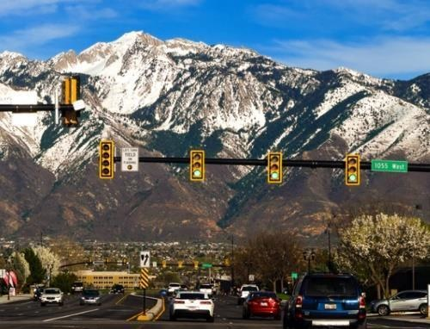
Traffic Incident Management
Traffic Studies
Road Weather Management
APPLICATION AREAS
Source: FHWA.
Source: Pixabay.
Source: Pixabay.
Traveler Information
Performance Management
Arterial Management
Source: Pixabay.
Source: Pixabay.
Source: Unsplash.

Slide 24
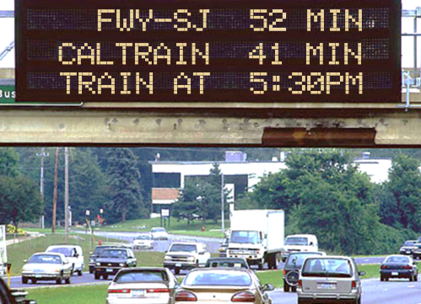

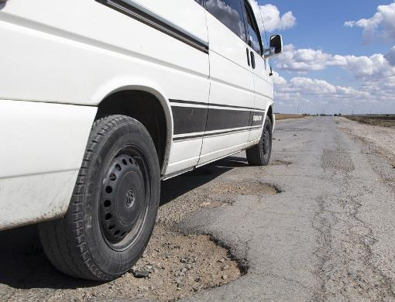

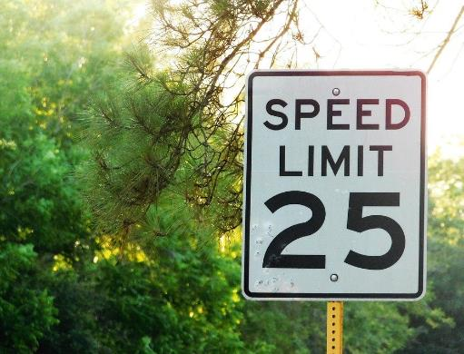

Freeway Management
Work Zone Management
Road and ITS Maintenance
Source: FHWA.
Source: Unsplash.
Source: Pixabay.
Project Prioritization
Emergency Management
Other Applications?
Source: Pixabay
Source: Unsplash.
Source: FHWA.
Source: Pixabay.

Slide 25
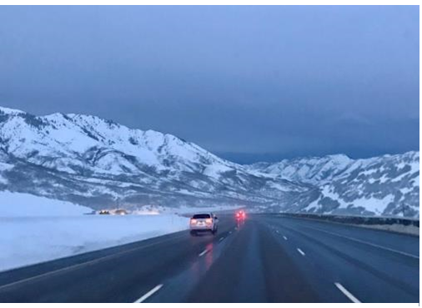
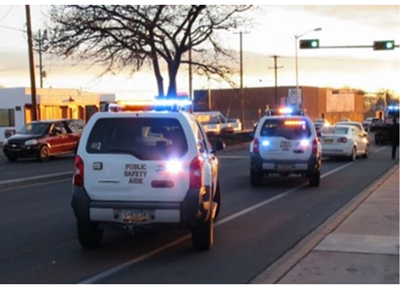
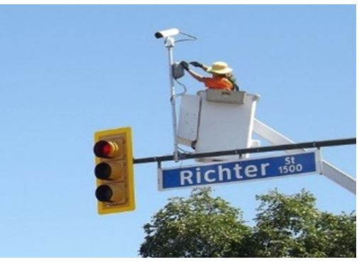
Why Crowdsourcing for Operations?
Improve Operations
Increase Safety and Reliability
Save Cost
Source: FHWA.
Source: FHWA.
Source: Pixabay.
25

Slide 26

Knowledge Check No. 1
What are the benefits from crowdsourcing for transportation operations?
Increase travel reliability
Improve traffic safety
Save cost
All of the above
Source: Unsplash.

Slide 27
Knowledge Check No. 2
Which of the following are benefits of using crowdsourcing data for transportation operations?
Fewer gaps in geographic coverage
Better timeliness of information
Less cost to install and maintain equipment
Fewer jurisdictional stovepipes
All of the above
Source: Unsplash.

Slide 28

LESSON 3: APPLICATION AREAS
Source: Pixabay.

Slide 29



Lesson Objectives
Become familiar with State and local uses of crowdsourced data
Understand that the same data can support multiple uses
All photos source: Unsplash.

Slide 30




Many Applications for Operations
Agencies typically begin with one source of crowdsourced data for a key need.
They quickly find the “one source” has many reuses!
And they find even greater value in integrating different data for real-time and archived uses.
Source (vertical): Unsplash.
Source (vertical): Pixabay.
Source (vertical): Pixabay.

Slide 31
Crowdsourcing in Dallas, Texas
North Central Texas Council of Governments (NCTCOG)
Natalie Bettger
Senior Program Manager
Congestion Management and System Operation
North Central Texas Council of Governments
nbettger@nctcog.org

Slide 32
NCTCOG 911 Department
Goal: NCTCOG 911 needed to identify crashes early for emergency response.
Action: Waze integration into forty-two 911 centers.
Outcome: Quicker notification of crashes, quicker response to crashes to save lives.
80% of the time, crashes reported to Public Safety Answering Point (PSAPs) 10 minutes earlier than WAZE, on average.
Remaining 20% of crashes were reported to WAZE first, 9 minutes before PSAPs, on average.

Slide 33
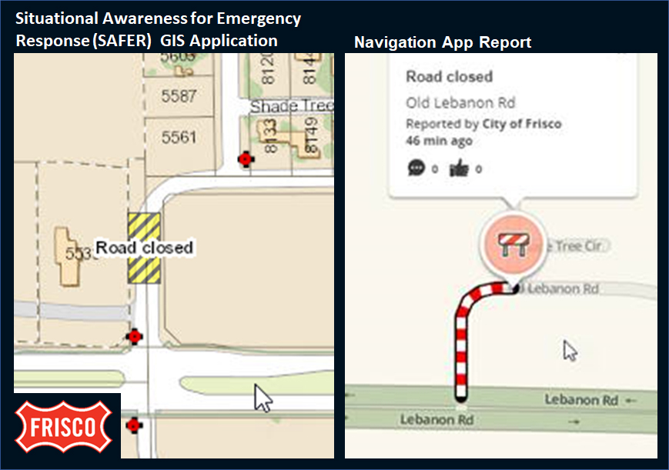
City of Frisco, Situational Awareness for Emergency Response (SAFER) Platform
Goal: Help public safety dispatchers provide accurate information to the responder community and road users.
Action: SAFER interfaces with Waze to share information multiple incident response communities.
Outcome: Quicker incident detection and response, and more timely and precise traveler information.

Slide 34
NCTCOG Traffic Signal Performance
Goal: Evaluate performance of and better manage all 7,000 traffic signals within the NCTCOG region.
Action: Purchase platform and data to analyze performance.
Outcomes: Identify non-performing signals, and whether additional
(Intended) capacity is needed.
Quickly identify malfunctioning traffic signal equipment,
Asses whether signal timing or coordination is needed.

Slide 35

Example: District Department of Transportation Crowdsources Pothole Detection
The District Department of Transportation (Washington, DC) launched a Potholepalooza campaign using social media.
11,000 potholes identified via crowdsourcing (e.g., 311 calls) and conventional, city employees’ reports in 3 months
10,000 potholes reported by its 650,000 Waze™ users in a month
Source: District DOT.

Slide 36

Kansas City Scout Crowdsourced Pothole Report Tool
Automated pull of potholes from Waze shared with maintenance
Field-evaluated reports
Expanding its use beyond Kansas City’s boundaries
Improvements in operations and safety
Image: Pexels.com/Kam Pratt, Data Source: Kansas City Scout.

Slide 37
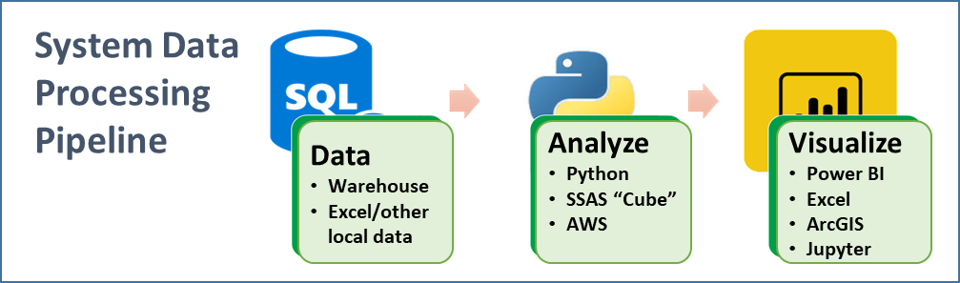
Example: Ohio DOT Uses Vehicle Probe Data for Nine Different Applications!
Collects 27,000 center-lane miles of interstate, U.S., and State route probe data. The agency applies the data for real-time and archived uses.
AWS = Amazon Web Services; SQL = Structured Query Language; SSAS = SQL Server Analysis Services.
Source: Ohio Department of Transportation.
Traffic Incident Management
Traffic Studies
Work Zone Management
Traveler Information
Project Prioritization
Road Weather Management
Freeway Management
Performance Management
Arterial Management

Slide 38
Knowledge Check
Ohio DOT uses vehicle probe data for how many applications?
One use
Five uses
Nine, that we know of
The agency does not use vehicle probe data.
Source: Unsplash.

Slide 39

Question, Answer, and Discussion
Source: Pixabay.
39

Slide 40
Application Example Resources
Adventures in Crowdsourcing Webinar: Business Case for Crowdsourced Data
Crowdsourcing Case Studies: City of Louisville, Indiana DOT, Lake County, IL, Kentucky Transportation Cabinet, and Utah DOT
Crowdsourcing Applications Table: Lists and describes public agency applications of crowdsourcing to improve transportation systems management and operations
Source: FHWA.
FHWA EDC-6 Crowdsourcing for Advancing Operation Resource Site (bit.ly/CS4Ops)

Slide 41
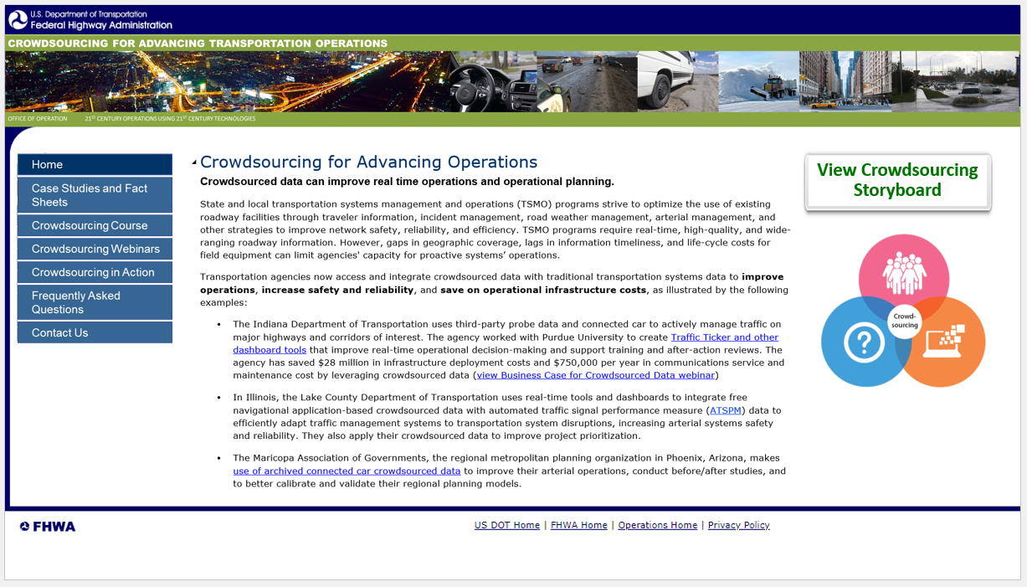
Crowdsourcing Beyond EDC-6
New web presence
Continue course delivery
Continue technical support
Continue free access to the EDC-6 Adventures in Crowdsourcing webinar series hosted by the National Operations Center of Excellence
Source: FHWA.
Concept website in development and intended for FHWA Office of Operations.

Slide 42
Thank you.
Be sure to join the next course webinar on Tuesday, June 20, 2023, at 1 p.m. ET to learn about crowdsourcing data sources and management.
James Colyar
james.colyar@dot.gov
360‒753‒9408
Greg Jones
gregm.jones@dot.gov
404‒895‒6220
Ralph Volpe
ralph.volpe@dot.gov
404‒985‒1268

Slide 43
Upcoming T3 Webinars
Webinar | Date | Time
Crowdsourcing for Advancing Operations: Data Sources and Management | Tuesday, June 20, 2023 | 1:00 P.M. - 2:30 P.M. ET
Crowdsourcing for Advancing Operations: Traveler Information and Traffic Incident Management | Tuesday, July 18, 2023 | 1:00 P.M. - 2:30 P.M. ET
Crowdsourcing for Advancing Operations: Road Weather and Arterial Management | Tuesday, August 15, 2023 | 1:00 P.M. - 2:30 P.M. ET
Crowdsourcing for Advancing Operations: Emergency and Work Zone Management and Next Steps | Tuesday, September 19, 2023 | 1:00 P.M. - 2:30 P.M. ET
Register: https://www.pcb.its.dot.gov/t3_webinars.aspx
To access the recording and past T3 webinars, visit:
https://www.pcb.its.dot.gov/t3_archives.aspx

Slide 44

Feedback
A link to a feedback questionnaire is provided in the chat pod. Please take a few minutes to fill it out – we value your input
To receive notifications of upcoming events, send an email to T3@dot.gov with “Add to mailing list” in the subject line
Thank you!

